Slide 1
COMP 41400 Multi-Agent Systems (MAS) Lectures 11 & 12 Agent Oriented Programming
Professor Gregory O’Hare,
Principal Investigator CONSUS (Crop OptimisatioN through Sensing, Understanding & viSualisation),
School of Computer Science
University College Dublin (UCD)

Slide 2
Introduction
Introduced in 1993 by Yoav Shoham (Stanford).
Based on the idea of programming agents as mental entities.
A complete AOP System includes three primary components:
a restricted formal language with clear syntax and semantics for describing mental states.
an interpreted programming language in which to define and program agents, with primitive commands (such as request and inform).
an ”agentifier”, converting neutral devices into programmable agents.
Shoham illustrated this through a prototype AOP language, Agent-0.

Slide 3

Non-Exhaustive List of APLs
1993 Agent-0
1995 PLACA / AgentSpeak(L)
1998 JACK / 3APL
2002 GOAL / AF-APL
2004 Jason
2008 2APL
2010 AF-AgentSpeak
2011 simpAL
2012 ASTRA
2014 Blueprint

Slide 4
COMP 41400 Multi-Agent Systems (MAS) Lectures 9 & 10 AgentSpeak(L)
Professor Gregory O’Hare,
Principal Investigator CONSUS (Crop OptimisatioN through Sensing, Understanding & viSualisation),
School of Computer Science
University College Dublin (UCD)

Slide 5
AgentSpeak(L)
Devised by Anund Rao in 1995:
A design for an AOP language – not an implementation
Attempts to bridge the gap between theory and practice
One-to-one correspondence between model theory, proof theory and abstract interpreter.
Based on a restricted first-order language with beliefs, goals, events and actions.
Implementations:
Jason (2004 – Bordini)
AF-AgentSpeak (2010 – Collier)
ASTRA (2012 – Collier)

Slide 6
AgentSpeak(L): The BDI Model
Mental State | Interpretation
Beliefs | as is the norm
Desires | represented as goals (assumed to be mutually consistent)
Intentions | plans that have been adopted to achieve goals
Dynamics:
Goal Generation: In response to changes to the environment and through sub-goals
Goal Selection: One goal per iteration with default ordering based on order of generation
Intention Achievement: Match goals to plans (with a context) that are executed in response to the goal
Key Idea:
Model dynamics in terms of events.

Slide 7
AgentSpeak(L): Basic Notions
Beliefs:
Define relationships between objects/concepts of interest to the agent.
Belief Structures:
Objects/concepts are represented as lower case identifiers known as constants.
gregory, man, ball, …
Predicates that define relationships between 1 or more objects.
isa(rem, man): represents the fact that rem is a man.
see(ball): represents the fact that the ball can be seen.
Examples:
likes(rem, beer) has(rem, beer)
hates(rem, apples) is(rem, silly)

Slide 8
AgentSpeak(L): Basic Notions
Belief Templates:
Belief templates are beliefs that contains variables
They can be matched against other beliefs using a process known as unification.
Variables are represented as upper case identifiers
X, Value, …
Examples:
likes(X, beer)
has(mary, Y)
likes(gregory, football)
hates(gregory, mushrooms)

Slide 9
AgentSpeak(L): Basic Notions
Unification:
Given two beliefs B₁ and B₂, we say that B₁ matches B₂ if it is possible to identify a set of variable bindings, σ, such that B₁ is the same as B₂ under the application of σ.
A given query belief is said to be true w.r.t to a belief set if it is possible to unify the query belief any belief in the belief set.
Example:
Consider the beliefs:
B₁ = likes(X, beer) B₂ = likes(rem, beer)
B₁ and B₂ can be unified by the variable binding set σ={X/rem}
B₁σ = likes(X, beer){X/rem} = likes(rem, beer)

Slide 10
AgentSpeak(L): Basic Notions
Lists:
In addition to constant and variable terms, most logic-based languages include support for lists (denoted using [ ]).
A list is a sequence of 0 or more terms (which themselves can be lists).
Example:
Consider the beliefs:
shopping_list([beer, crisps, pizza, wine])
Typically, the language will provide some mechanism to split a list into its head (the first term in the list) and a tail (the remainder of the terms).
For example, [H|T] can be unified with a list: {H/beer, T/[crisps, pizza, wine]}
You can also unify enumerated lists: shopping_list([A, B, C, D])

Slide 11
AgentSpeak(L): Basic Notions
Goals:
What the agent wants to achieve (predicates prefixed with !)
!find(ball), !goto(rem), …
Informally, goals indicate future states that the agent wishes to achieve.
In AgentSpeak(L), the agent does not check that the state is achieved.
A goal is assumed to have been achieved when:
A plan has been adopted to achieve the goal
The plan has been successfully executed.
If an appropriate plan cannot be found or the agent fails to execute the plan successfully, then the goal is not achieved.

Slide 12
AgentSpeak(L): Basic Notions
Events:
Represent changes to the agents beliefs / goals.
an event can be
internal, when a subgoal needs to be achieved
external, when generated from belief updates as a result of perceiving the environment.
there are two types of events:
related to the addition (‘+’) and deletion (‘-’) of beliefs or goals
Example:
Consider a simple agent monitoring a light switch.
When the light switch is pressed, the agent has a belief switch(on) and when the light switch is not pressed, the agent has a belief switch(off).
Pressing the light switch causes the agent to drop the latter belief and adopt the former belief.
This would lead to 2 belief events: -switch(off) and +switch(on)

Slide 13
AgentSpeak(L): Basic Notions
Plans:
the basic abilities of an agent (i.e. how it can affect its environment).
te : ct <- h
Where:
te - triggering event (denoting the purpose for that plan)
ct - a logical sentence describing the conditions under which the plan is applicable.
h - a sequence of basic actions or (sub)goals that the agent has to achieve (or test) when the plan, if applicable, is chosen for execution.

Slide 14
AgentSpeak(L): Basic Notions
Plans:
The context is a logical statement that determines when the agent should consider the plan.
Belief literals are conjoined (&).
Belief literals can be positive (beliefs) or negative (negated beliefs)
Negated beliefs are beliefs that are prefixed by the not (~) operator
The agent interpreter processes the context using a technique known as resolution.
This basically means that the interpreter processes the conjoined beliefs in a left-to-right order attempting to build a set of variable bindings that cause all belief literals to be evaluated to true w.r.t. the belief base.
Remember the matching is done through unification.
We say that the statement is true if a set of variable bindings can be found, and false otherwise.
Where necessary, the context can be used to introduce additional variable bindings that can be used in the plan body.

Slide 15
AgentSpeak(L): Basic Notions
Plans:
Beliefs:
likes(joe, beer)
likes(rian, beer)
has(rian, beer)
wants(joe, beer)
wants(rian, beer)
Example Context:
likes(X, Y) & wants(X, Y) & has(X, Y)
What variable bindings cause this context to be satisfied?

Slide 16
AgentSpeak(L): Basic Notions
Plans:
The plan body part defines the behaviour to be executed should the plan be selected.
It is basically a sequence of statement, separated by a semi-colon (;) and terminated by a period (.).
In AgentSpeak(L), the following statement types are supported:
Belief Updates: +<belief> to add a belief, -<belief> to remove a belief
Test goals: ?<belief> succeeds if the belief can be resolved, fails otherwise
Sub-goals: <goal> specifies a sub-goal that should be achieved.
Private Actions: internal actions of the agent that can be executed atomically.

Slide 17
AgentSpeak(L): Basic Notions
Belief Updates
Allow you to directly add or remove beliefs
Associated events are generated on the successful execution of the statement.
Test Goals
Allow you to test whether or not a certain state exists.
?likes(rem, beer) // does rem like beer?
?likes(X, coffee) // who likes coffee?
?is(rem, Y) // what is rem?
Statement | Effect | Event Generated
-count(0) | Removes the belief count(0) | -count(0) is generated if the belief was actually removed.
+count(1) | Adds the belief count(1) | +count(1) is generated if the belief was not previously in the belief set.

Slide 18
AgentSpeak(L): Basic Notions
Sub-goals
A sub goal is a decision point.
It can be used to select a course of action from a set of options.
It can be used to make a decision on whether to continue with a course of action.
Declaring a sub goal causes a goal addition event.
This event handled in the usual way.
In some respects, it is like a method call.
Unlike method calls, the decision on which behavior to execute is delayed until the invocation time and is selected contextually.
This is a key feature of AgentSpeak(L)
Delayed decision making allows more flexible and robust patterns of behavior execution.
The agent only chooses a course of action when necessary based on the current state of the system rather than a predicted state.

Slide 19
AgentSpeak(L): Basic Notions
Sub-goals for selections:
+!evaluate(X) : X % 2 == 0 <-
print(“X is even”).
+!evaluate(X) : X % 2 == 1 <-
print(“X is odd”).
!evaluate(5).
Sub-goals for loops:
+!loop(X, N) : X < N <-
print(“do something”);
!loop(X+1, N).
+!loop(X, N) : X == N <-
print(“finished”).
!loop(0, 5).

Slide 20
AgentSpeak(L): Basic Notions
Example Plans:
“If we believe a concert by artist A will take place at venue V and we like A, adopt an achievement goal to book tickets for the concert.”
+concert(A,V) : likes(A) <-
!book_tickets(A,V).
“If we have a goal to book tickets and the phone is not busy, call the venue and adopt an achievement goal to choose seats.”
+!book_tickets(A, V) : ~busy(phone) <-
call(V);
!choose seats(A,V).

Slide 21
AgentSpeak(L): Basic Notions
Intentions: plans the agent has chosen for execution.
Represented as a stack.
Intentions are executed one step at a time:
query or change the beliefs
perform an action on the external world
submit new goals.
The operations performed by a step may generate new events, which, in turn, may start new intentions.
An intention succeeds when all its steps have been completed; it fails when certain conditions are not met or actions being performed report errors.

Slide 22
AgentSpeak(L): Interpreter
select an event, e, from the agents event queue
match the event to a plan rule, p whose triggering event matches e, and whose context is satisfied.
if e is a belief adoption / retraction event then create a new intention to process the behaviour specified in p else update the intention that generated e to also process the behaviour specified in e.
select one intention, i and execute its next step.
return to 1

Slide 23
AgentSpeak(L): Interpreter
Algorithm Interpreter()
// Process the next event
e <- selectEvent()
if (e != ᴓ) then
o <- selectOption(e)
if (o != ᴓ) then
applyOption(o)
endif
endif
// Perform an action
i<- selectIntention()
if (i != ᴓ) then
executeIntention(i)
endif

Slide 24
AgentSpeak(L): Summary
AgentSpeak(L) is a theoretical (but computationally tractable) AOP language.
The central concept in AgentSpeak(L) is the notion of a partial plan that can be applied to resolve some triggering condition in some context.
AgentSpeak(L) says nothing about communication, although communication is easy to add.
But, AgentSpeak(L) has been used as a basis to explore a range of more advanced concepts (cooperation, organization, …)

Slide 25
COMP 41400 Multi-Agent Systems (MAS) Lectures 11 & 12 Interlude Modelling State
Professor Gregory O’Hare,
Principal Investigator CONSUS (Crop OptimisatioN through Sensing, Understanding & viSualisation),
School of Computer Science
University College Dublin (UCD)

Slide 26
Modelling State
Beliefs are state:
Beliefs represent the internal knowledge and external environment of the agent.
Beliefs specify what objects exist and how they are related.
We use these to make decisions about how to act.
To work with beliefs, we must first decide what beliefs the agent will have and what they mean…
This is often termed an ontology.
When creating an ontology, we should consider:
What types constants will exist (it is not always possible to know in advance what objects there will be)
What relationships exist between the different types of object.

Slide 27
Modelling State: Example
Consider a simple table with a set of blocks on it….
We can model this as follows:
Constants: a, b, c, d, table
Some Relationships:
block(X) – belief that X is a block
table(X) – belief that X is a table
on(X, Y) – belief that X is sitting on top of Y
free(X) – belief that block X has nothing on it
a
b
d
c
table

Slide 28
Modelling State: Example
The Initial State
block(a) block(b)
block(c) block(d)
table(table)
on(a, table) on(b, table)
on(c, table) on(d, table)
free(a) free(b)
free(c) free(d)
a
b
d
c
table

Slide 29
AgentSpeak(L): Basic Notions
Another State:
block(a) block(b)
block(c) block(d)
table(table)
on(a, table) on(b, d)
on(c, table) on(d, table)
free(a) free(b)
free(c)
b
a
d
c
table

Slide 30
From Fields to Beliefs
Beliefs refer to state:
In OOP, state is defined in terms of a set of fields that hold values (or object references).
For example, int value; declares an integer field with name value.
Fields are, typically, given a default initial value, which in the case of an integer is 0.
In AgentSpeak(L), state is defined in terms of a set of beliefs that define relations on values.
For example, the belief value(0) declares a belief whose name is value and whose value is 0.
So, the way we define that state of an object seems to have an equivalent for beliefs…

Slide 31
From Fields to Beliefs
Type | Java | AgentSpeak(L)
Primitives | double balance; int age = 42; String name = “bob”; | balance(0.0) age(42) name(bob)
Arrays | int[] array; int[] ages = {42, 8, 6} | array([]) ages([42, 8, 6])
Data Classes | class person { public String name; public int age; public char sex; } | Modelled as predicates or functional terms: person(rem, 42, m) person(tanya, 6, f) person(coral, 8, f)
Maps | Map<String, String> parents = new HashMap<String, String>(); parents.put(“tanya”, “rem”); parents.put(“coral”, “rem”); | parents(tanya, rem) parents(coral, rem)
Sets | Set<String> lecturers = new HashSet<String>(); lecturers.add(“henry”); lecturers.add(“rem”); | lecturers(henry) lecturers(rem)

Slide 32
Beliefs as Fields
Two operations commonly associated with fields are:
Assignment: e.g. value = 5; or name = “Rem”;
Comparison: e.g. value == 3 or name.equals(“Fred”)
AgentSpeak(L) offers equivalents to these operations:
Assignment: this involves first dropping the existing belief and then adopting a new belief with the new value: -value(0); +value(5) or –name(“Bob”); +name(“Rem).
Comparison: this can be done in two places – the plan rule context or via a query statement:
<tr> : name(“Fred”) <- … or ?name(“Fred”).
It is important to note that assignment is atomic in OOP languages, but is not atomic in AgentSpeak(L).

Slide 33
COMP 41400 Multi-Agent Systems (MAS) Lectures 11 & 12 Programming Agents in Jason
Professor Gregory O’Hare,
Principal Investigator CONSUS (Crop OptimisatioN through Sensing, Understanding & viSualisation),
School of Computer Science
University College Dublin (UCD)

Slide 34
Introduction
Jason was released in 2004
Developers: Rafael Bordini and Jomi Hubner
Complete implementation of AgentSpeak(L) & more:
Library of private actions
Annotation model for beliefs / goals
Support for agent communication based on KQML
Prolog-style inference supported
Clear agent/environment interface
Customisable interpreter cycle
Lots of example solutions can be downloaded with the main framework…

Slide 35
Jason: Internal Actions
Library of pre-written actions that can be used directly by the agent without needing to setup an environment:
.abolish(<belief>) drop all matching beliefs
.broadcast(<perf>, <content>)send content to all agents
.fail() action that fails
.print() print to the console
.println() print a line to the console
Full list: http://jason.sourceforge.net/api/jason/stdlib/package-summary.html

Slide 36
Jason: Annotation Model
Mechanism for adding tags to beliefs (and goals) – represent, for example, the source of a belief or a certainty factor.
blue(box1)[source(ag1)]
red(box1)[source(percept)]
colourblind(ag1)[source(self), cf(0.7)]
liar(ag1)[source(self), cf(0.2)]
Querying of beliefs can include annotations:
?blue(X) // is there a blue box?
?blue(X)[source(Y)] // is there a blue box and // who told me?
?red(X)[source(percept)] // did I perceive a red box?
?colourblind(X)[source(ag1)] // did ag1 tell me that X // is colour blind?

Slide 37
Jason: Beliefs
Unlike AgentSpeak(L) which uses standard Boolean logic, Jason supports strong negation:
In Boolean logic, facts relate to “truths” about the problem being modelled.
Any other possible facts are considered unknown and this is interpreted as being not true.
In Jason, the agent also stores beliefs (facts) relating to things it knows are false (such as ~likes(rem, apples)).
In this way, the agent can explicitly represent what it knows to be true and what it knows to be false.
The Boolean not operator is represented by the keyword not.
This allows the programmer to differentiate between:
something that is definitely true: X
something that is definitely false: ~X
and something that is unknown: not X & not ~X
To revert to Boolean logic, you should simply not use strong negation.

Slide 38
Jason: Agent Communcation
KQML-based communication:
Performatives (incomplete): tell, untell (knowledge transfer) achieve, unachieve (asking for help
Sending Messages: .send(<receiver>, <perf>, <content>)
Receiving Messages: +!kqml_received(<sender>,<perf>,<content>,<msg_id>)
Default semantics of message passing:
.send(X, tell, Y) X adds belief Y[source(<sender>)]
.send(X, achieve, Y) X adds goal !Y[source(<sender>)]
.send(X, untell, Y) X drops belief Y[source(<sender>)]

Slide 39
Programming with Jason
Jason can be programmed through jEdit plugin or through and Eclipse plugin (preferred).
Installation Tutorial: http://jason.sourceforge.net/mini-tutorial/eclipse-plugin/
Jason programs consist of two file types:
AgentSpeak Language files (.asl) – the agent code
Deployment Files (.mas2j) – platform configuration

Slide 40
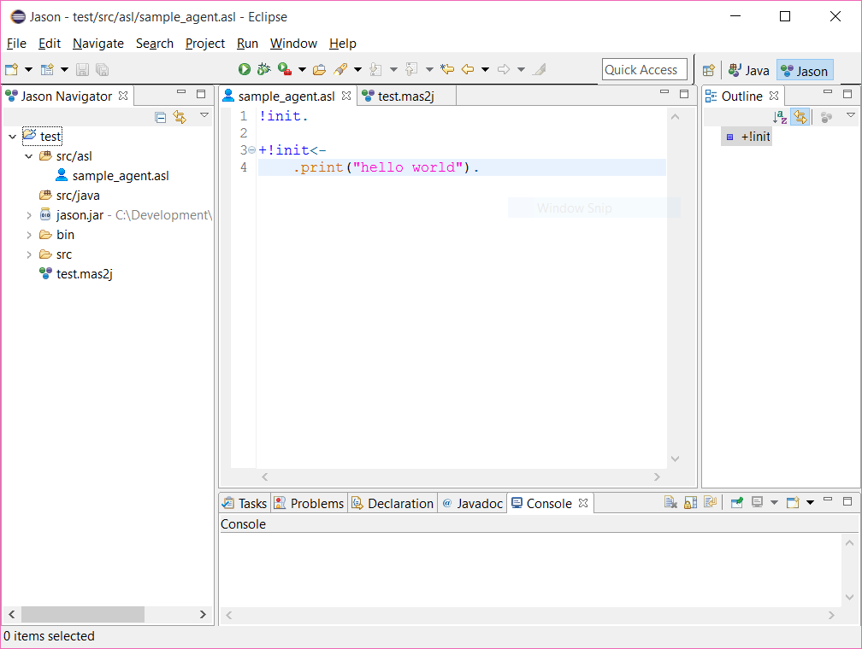
Programming with Jason

Slide 41
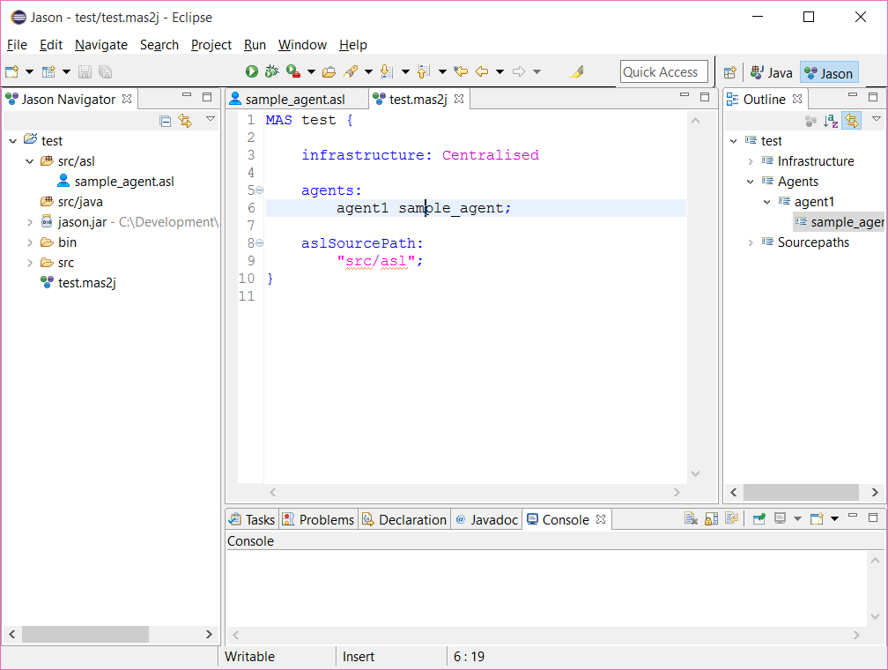
Programming with Jason

Slide 42
Jason: Hello World
Hello World:
!hello.
+!hello <- .print(“hello world”).
Hello World (3 Times):
!hello(3).
+!hello(X) : X > 0 <-
.print(“hello world”);
!hello(X-1).

Slide 43
Jason: Subgoals
!init.
+!init <- !printHello().
+!printHello <- .println(“hello world”).
!init.
+!init <- !printHello(3).
+!printHello(X) : X > 0 <-
.println(“hello world”);
!printHello(X-1).

Slide 44
Jason: Belief Queries
// initial beliefs
is(rem, happy).
// initial goal
!init.
// main rule
+!init <-
.println(“starting”);
?is(rem, happy);
.println(“first hurdle passed”);
?is(rem, sad);
.println(“ending”).

Slide 45
Jason: Belief Update
light(on).
+light(on) <-
.println(“the light is on, turn it off”);
-light(on);
+light(off).
+light(off) <-
.println(“the light is off, turn it on”);
-+light(on).

Slide 46
Jason: Fibonacci
Fibonacci Number Generator:
+!fib(X, N) : X < N & fib(X-1, Y) & fib(X-2, Z) <-
+fib(X, Y+Z);
!fib(X+1, N).
+!fib(X, N) : X == N & fib(X-1, Y) & fib(X-2, Z) <-
+fib(X, Y+Z).
The behaviour is triggered by the following initial mental state:
fib(1,1).
fib(2,1).
!fib(3,50). // generates the first 50 numbers...

Slide 47
Jason: Ping-Pong
Ping Agent:
!start.
+!start <-
.println("starting...");
.wait(500);
.send(bob, achieve, ping).
+!ping <-
.println("ping");
.wait(500);
.send(fred, achieve, pong).
Pong Agent:
+!pong <-
.println("pong");
.wait(500);
.send(bob, achieve, ping).

Slide 48
Jason: Ping-Pong
MAS test {
infrastructure: Centralised
agents:
fred pong;
bob ping;
aslSourcePath:
"src/asl";
}

Slide 49

Things to Do!
Read and take notes on Agentspeak(L)
https://link.springer.com/chapter/10.1007/BFb0031845
Read and take notes on:
https://link.springer.com/chapter/10.1007%2F11750734_9
Familarise yourself with:
http://jason.sourceforge.net/wp/

